Slide 1
Workshop on Statistics & Probability
Dept of Electronics & communications engg.
Maharaja institute of technology
15, 16 oct 2016

Slide 2
LIMIT THEOREMS

Slide 3
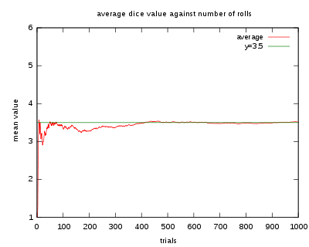
Law of large numbers
It is true that with each coin toss you have a 50/50 chance of getting heads; however, if you toss a coin repeatedly, you cannot be certain that 50% of the tosses will land on heads or vice versa unless you use the law of large numbers. This is because the law of large numbers dictates that as we increase the number of times we toss the coin, we get closer and closer to achieving a 50% probability of getting heads (or 50% for tails!). So, if you have the time to toss a coin thousands of times, you can be pretty sure that just about half of the tosses will land on heads!
Number of Tosses | Number of Heads | Probability of Heads
4 | 1 | 25%
100 | 64 | 64%
1000 | 582 | 58.2%
10000 | 4989 | 49.89%

Slide 4
Law of large numbers(Conti…)
Have you ever seen a contest where there is a jar full of jelly beans along with a prize for the person who guesses how many jelly beans there are inside?
If you try to guess, your answer may not come too close to the total number of jelly beans in the jar. The same may be true if you average the guesses of ten people who give it a try, but what happens if 1,000 people each take a guess and we average their guesses? Interestingly, that average will likely be a lot closer to the actual number of jelly beans in the jar. Which means the probability of guessing the correct amount of jelly beans is higher. As a matter of fact, as the number of guesses increases, the average of the guesses will come closer and closer to the actual number of jelly beans. This is the law of large numbers in action!

Slide 5
Central limit theorem
A large freight elevator can transport a maximum of 9800 pounds. Suppose a load of cargo containing 49 boxes must be transported via the elevator. Experience has shown that the weight of boxes of this type of cargo follows a distribution with mean µ = 205 pounds and standard deviation σ = 15 pounds. Based on this information, what is the probability that all 49 boxes can be safely loaded onto the freight elevator and transported?
n= 49, P(T < 9800) = P(z < 9800−49(205) √ 4915 ) = P(z < −2.33) = 1 − 0.9901 = 0.0099

Slide 6
BASIC STATISTICS

Slide 7
Standard error(se)
The standard error is a measure of dispersion similar to the standard deviation. However, while the standard deviation provides information on the dispersion of sample values, the standard error provides information on the dispersion of values in the sampling distribution associated with the population of interest from which the sample was drawn. Standard error statistics measure how accurate and precise the sample is as an estimate of the population parameter. It is particularly important to use the standard error to estimate an interval about the population parameter when an effect size statistic is not available.
The standard error of the sample mean is an estimate of how far the sample mean is likely to be from the population mean, whereas the standard deviation of the sample is the degree to which individuals within the sample differ from the sample mean.

Slide 8
Type-1 & type-2 errors
Type I error
When the null hypothesis is true and you reject it, you make a type I error. The probability of making a type I error is α, which is the level of significance you set for your hypothesis test. An α of 0.05 indicates that you are willing to accept a 5% chance that you are wrong when you reject the null hypothesis. To lower this risk, you must use a lower value for α. However, using a lower value for alpha means that you will be less likely to detect a true difference if one really exists.
Type II error
When the null hypothesis is false and you fail to reject it, you make a type II error. The probability of making a type II error is β, which depends on the power of the test. You can decrease your risk of committing a type II error by ensuring your test has enough power. You can do this by ensuring your sample size is large enough to detect a practical difference when one truly exists.
The probability of rejecting the null hypothesis when it is false is equal to 1–β. This value is the power of the test.
Null Hypothesis
Decision | TRUE | FALSE
Fail to reject | Correct decision(p = 1 - ) | Type II Error(p = )
Reject | Type II Error(p = ) | Correct decision(p = 1 - )

